Slide 1

MARKET ANALYSIS
IPCS Global Kollam
Digital Marketing Market Analysis Report
Prepared for
Scope
Digital Marketing Course
Market Analysis Assignment
Market • Competitors • SEO
Website • Social • Branding

Slide 2
01 | Brand Overview
What IPCS Global Kollam currently communicates online
Positioning
Course Portfolio
Career Proposition
Digital marketing training institute in Kollam with practical, industry-oriented training and multiple course formats.
Professional Diploma • Advanced Certificate • SEO • SEM • SMM • Affiliate Marketing • Analytics and more.
Live industrial experience, internships, industry-expert trainers, certifications and placement-oriented learning.
USP Opportunities
Key Finding
• Established IPCS brand
• Broad digital-marketing curriculum
• Real-time industry exposure
• In-campus + online training
• Central Kollam location (Chinnakada)
The offer is strong, but the Kollam story can be more distinctive: show local student outcomes, projects, trainer expertise and day-to-day classroom experience.
IPCS GLOBAL KOLLAM • MARKET ANALYSIS | 02

Slide 3
02 | Market & Target Audience
Primary audiences and what motivates them
College Students
Fresh Graduates
Career Switchers
Want job-ready skills alongside degree studies.
Need practical experience, portfolio and employability.
Look for a structured entry into digital roles.
Entrepreneurs
Working Professionals
Core Persona
Need SEO, social media, ads and analytics to grow a business.
Upskill for performance marketing, content and analytics.
Age: ~18–30
Location: Kollam + nearby districts
Need: practical skills + career confidence
Decision factors: fees, credibility, projects, placements, reviews
IPCS GLOBAL KOLLAM • MARKET ANALYSIS | 03

Slide 4
03 | Competitor Analysis
How the local offer is positioned online
Factor
IPCS Global
CIIM
Dmake Academy
Core positioning
Broad, industry-oriented training
AI + certification + placement
Agency-based + AI + practical
Practical exposure
Internships / industrial experience
Live projects + internship
Real client projects + agency internship
Course breadth
Very broad digital menu
73+ modules / multiple programs
Digital marketing + multimedia
AI positioning
Opportunity to strengthen
Strong and explicit
Strong and explicit
Local differentiation
Established Kollam presence
Strong performance-marketing proposition
Kollam agency ecosystem
Strategic takeaway: competitors increasingly lead with AI, agency experience, live projects and explicit career outcomes. IPCS should make these benefits visible and Kollam-specific.
IPCS GLOBAL KOLLAM • MARKET ANALYSIS | 04

Slide 5
04 | Keyword Research
Keyword clusters to target in organic search and content
High-Intent / Primary
Service Keywords
Long-Tail / Conversion
digital marketing course in Kollam
digital marketing institute in Kollam
digital marketing training Kollam
best digital marketing institute Kollam
SEO course Kollam
social media marketing course Kollam
Google Ads course Kollam
digital marketing certification Kollam
AI digital marketing course Kollam
digital marketing course with placement Kollam
course for students in Kollam
AI integrated digital marketing course
job oriented digital marketing course
Content Keyword Themes
Measurement Plan
• Careers after BCom / graduation
• How to become a digital marketer
• SEO vs Google Ads
• AI tools for marketers
• Digital marketing salary / roles
Track impressions, clicks, CTR, average position and conversions in Google Search Console. Use Keyword Planner/Trends for demand and competition before assigning numerical targets.
IPCS GLOBAL KOLLAM • MARKET ANALYSIS | 05

Slide 6
05 | Website Audit
Qualitative audit of the public Kollam landing page
Content
Conversion
GOOD
GOOD
Strong course depth and clear learning areas.
Enquiry form + contact/WhatsApp route are present.
Local SEO
Differentiation
GOOD
IMPROVE
Kollam, Chinnakada and branch address are clearly stated.
Local proof and student outcomes can be more prominent.
UX / Trust
Performance
IMPROVE
TEST
Add stronger above-the-fold proof: reviews, projects, trainer credentials, outcomes.
Run PageSpeed/Core Web Vitals and mobile checks before reporting scores.
Audit note: no invented speed/technical scores are included. Add your own PageSpeed Insights and mobile screenshots to validate technical findings.
IPCS GLOBAL KOLLAM • MARKET ANALYSIS | 06

Slide 7
06 | SEO Analysis
Priorities for stronger local search visibility
On-Page SEO
Local SEO
Technical SEO
Use one clear primary keyword per landing page.
Strengthen title/H1/meta copy around Kollam intent.
Add FAQ content targeting long-tail searches.
Fully optimize Google Business Profile.
Consistent NAP information.
Collect genuine student reviews.
Publish Kollam-specific updates.
Check Core Web Vitals, indexability, sitemap, robots.txt, canonical tags, image alt text and structured data.
Content SEO
Priority Keywords
Create supporting articles around careers, course comparisons, AI tools, SEO, social media and student projects. Internally link every article to the main Kollam course page.
1. digital marketing course in Kollam
2. digital marketing institute in Kollam
3. digital marketing training Kollam
4. AI digital marketing course Kollam
5. digital marketing course with placement Kollam
IPCS GLOBAL KOLLAM • MARKET ANALYSIS | 07

Slide 8
07 | Social Media Analysis
Recommended audit framework and content direction
What to Audit
Content Mix
Gap to Exploit
Instagram: followers, reach, views, saves, shares, comments, profile visits.
Facebook: reach + community proof.
YouTube: views, retention, searchability.
Reels • student stories • classroom clips • trainer tips • AI tutorials • project showcases • placement updates • FAQs.
Make content feel local and human. Show real faces, real projects and real learning rather than relying mainly on promotional posters.
Suggested Weekly Rhythm
KPIs
Mon — Career tip Reel
Tue — Student/project story
Wed — AI tool tutorial
Thu — Trainer/FAQ Reel
Fri — Classroom BTS
Sat — Course/CTA post
Sun — Community/testimonial
Reach → profile visits → WhatsApp/enquiry clicks → counselling/demo registrations → admissions. Track saves and shares as quality indicators for educational content.
IPCS GLOBAL KOLLAM • MARKET ANALYSIS | 08

Slide 9
08 | Branding & Content Analysis
Build a clearer reason to choose IPCS Kollam
Brand Strengths
Brand Challenge
Proposed Message
Established name • broad course portfolio • industry orientation • certifications • practical exposure.
The wider IPCS identity can overshadow the local branch. Kollam should have a recognizable content voice and proof system.
“Learn digital marketing by doing — with industry exposure, practical projects and career-focused support in Kollam.”
Content Pillars
Creative Direction
01 Career & skills
02 Student transformation
03 Real projects / portfolio
04 AI + tools
05 Trainer expertise
06 Local community / events
Use consistent typography, real student photography, short-form video, strong hooks, proof-led CTAs and a recurring visual identity across Instagram, website and WhatsApp creatives.
IPCS GLOBAL KOLLAM • MARKET ANALYSIS | 09

Slide 10
09 | SWOT Analysis
Strategic snapshot
STRENGTHS
WEAKNESSES
• Established IPCS brand
• Broad course portfolio
• Industry-expert trainer positioning
• Internship / industrial exposure
• Central Kollam presence
• Kollam-specific proof can be stronger
• Local content identity can be clearer
• Need more visible student outcomes
• Technical SEO/performance should be continuously audited
OPPORTUNITIES
THREATS
• AI + digital marketing demand
• Local SEO
• Malayalam + English content
• College collaborations
• Student-generated content
• YouTube educational search traffic
• Growing local competition
• AI-focused academies
• Online course platforms
• Price-based competition
• Student skepticism around placement claims
IPCS GLOBAL KOLLAM • MARKET ANALYSIS | 10

Slide 11
10 | Recommendations & Improvements
90-day action plan
1
Own local search
Build/refresh Kollam landing pages, GBP, reviews and local backlinks.
2
Show proof
Publish weekly student projects, testimonials, trainer expertise and internship stories.
3
Lead with AI + practical
Demonstrate actual tools, workflows and campaign outcomes—not just claims.
4
Build a content funnel
Reel → profile → landing page → WhatsApp/counselling → admission.
5
Measure everything
Monthly dashboard: rankings, organic clicks, leads, social reach, enquiries and conversions.
Priority: local SEO + proof-led content + conversion tracking
IPCS GLOBAL KOLLAM • MARKET ANALYSIS | 11

Slide 12
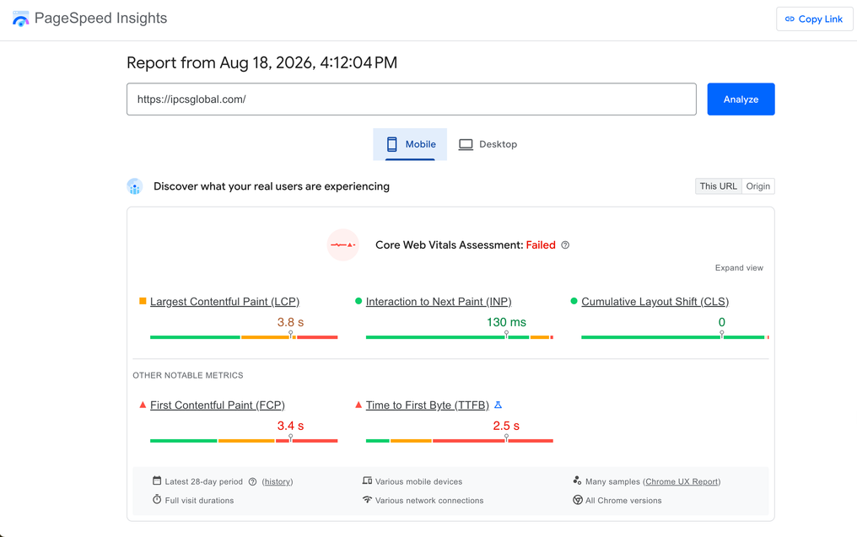
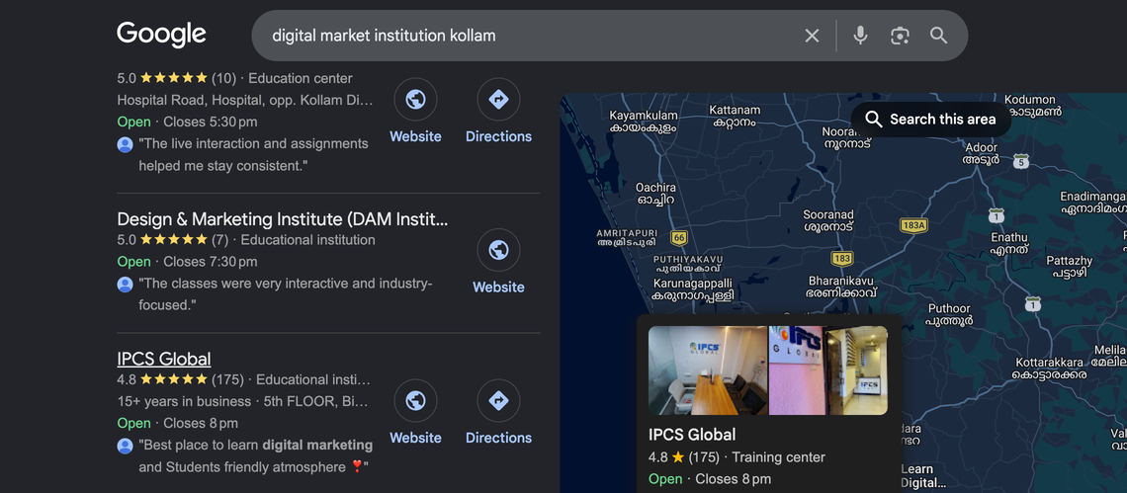
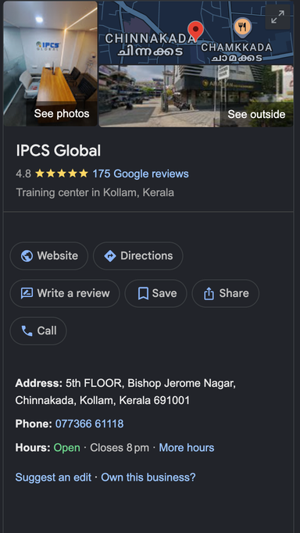
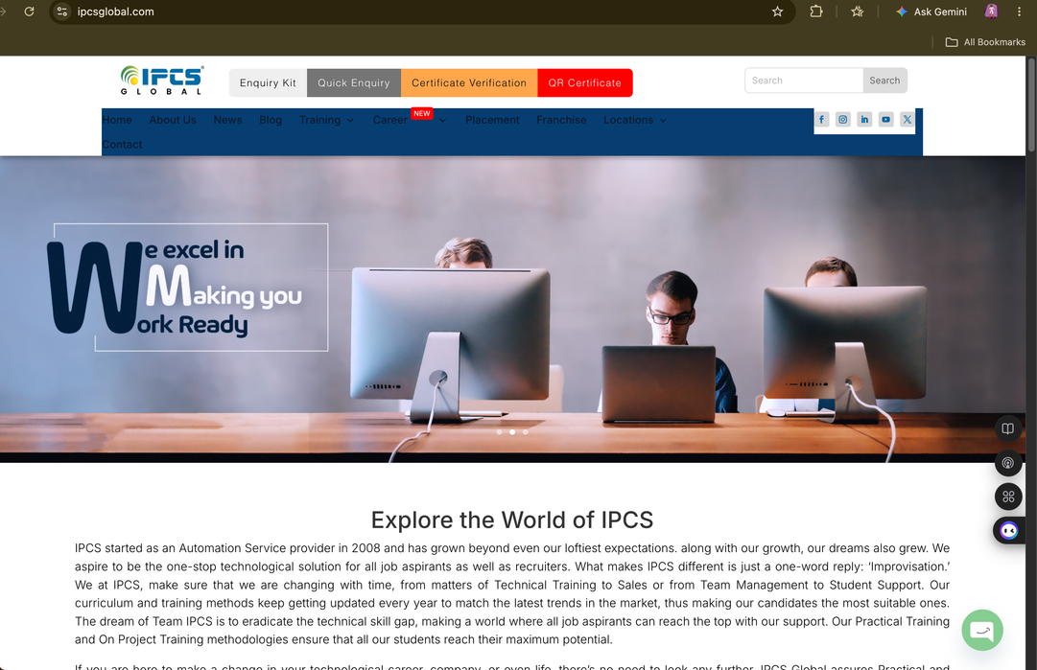
11 | OBSERVATION

Slide 13
12 | Conclusion
The opportunity is not only to compete — it is to become the most visible, proof-driven digital marketing brand in Kollam.
Market
Competition
Growth Lever
Demand is career-led: students and professionals want practical, employable skills.
Competitors increasingly emphasize AI, agency exposure, live projects and placement support.
IPCS can win through stronger local SEO, authentic proof and consistent educational content.
FINAL RECOMMENDATION
Make IPCS Global Kollam visible everywhere a prospective student searches, learns, compares and asks for proof.
Sources: IPCS Global Kollam official course page; CIIM Kollam official course page; Dmake Academy official site. Competitor claims are presented as published by the respective brands.
IPCS GLOBAL KOLLAM • MARKET ANALYSIS | 12

